Slide 1

Interpretable Machine Learning for Diabetes Prediction: Balancing Accuracy and Transparency
Seminar Interpretable Machine Learning
Name: As Am Mehedi Hasan
Id: 23071082

Slide 2

Agenda
Introduction & Motivation
Why interpretable ML in healthcare is important.
Models
Logistic Regression, Gradient Boosting, Neural Network.
Interpretability
LIME, SHAP, Permutation Importance
01
02
03
04
05
06
Dataset & Preprocessing
Pima dataset, cleaning, missing values.
Evaluation
Performance metrics + Cross-Validation
Discussion & Conclusion
Trade-offs, insights, future work

Slide 3
Introduction

Slide 4

Motivation
Why Interpretability Matters
Machine learning is increasingly used in clinical decision support.
In high-stakes domains, accuracy alone is insufficient — decisions must be explainable.
Black-box models may achieve strong predictive power but risk loss of trust and accountability.
Interpretability enables clinicians to understand, validate, and trust predictions.

Slide 5
Research Objective
Aim of the Study
Evaluate the trade-off between performance and transparency in diabetes prediction.
Compare:
Logistic Regression → interpretable by design
Gradient Boosting & Neural Network → black-box models
Apply local (LIME, SHAP waterfall) and global (SHAP bar, beeswarm, permutation importance) explanation methods.
Assess whether results are consistent with medical knowledge (e.g., glucose, BMI, age).

Slide 6
Hypotheses
Content
H1: Black-box models achieve slightly higher predictive performance than Logistic Regression.
H2: Post-hoc explanations recover feature importance consistent with interpretable models and clinical evidence.
H3: Combining interpretable and black-box approaches enhances the trustworthiness of machine learning in healthcare.

Slide 7
Dataset & Preprocessing

Slide 8
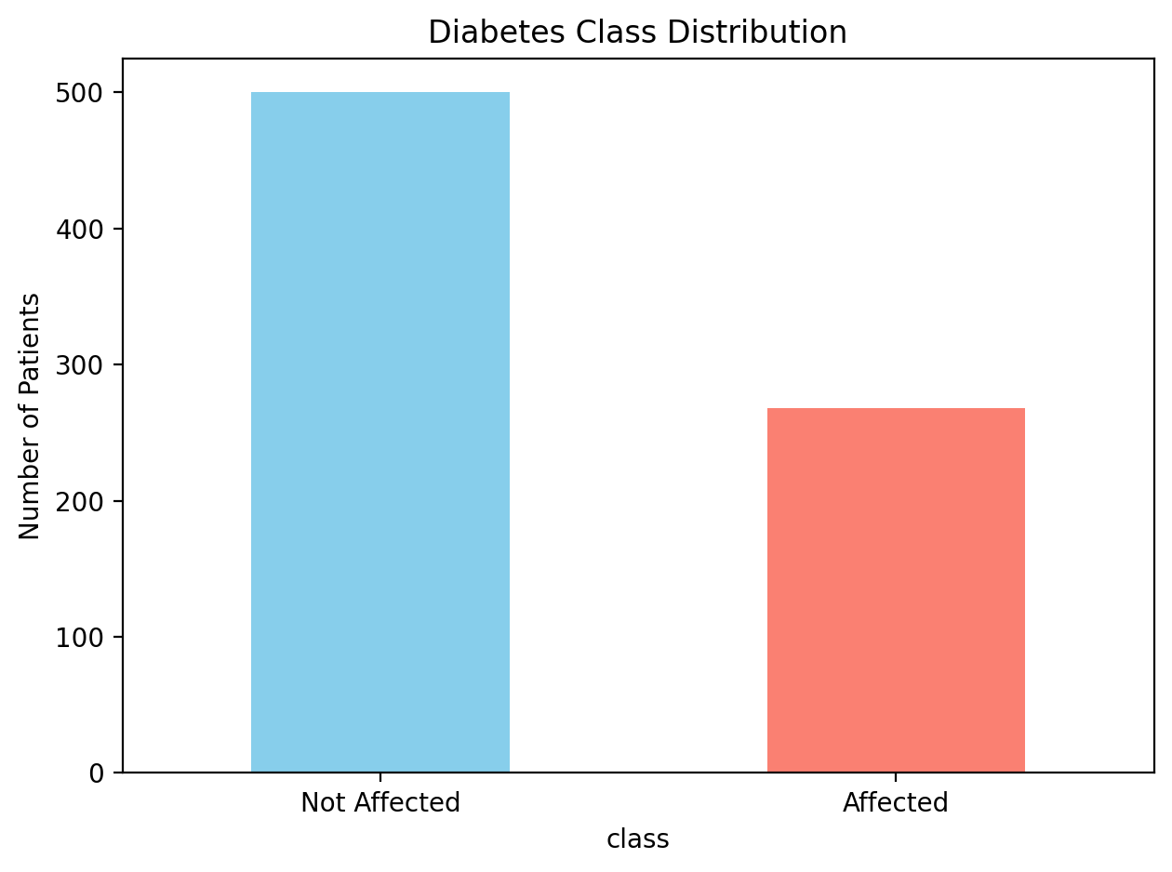
Dataset Overview
Pima Indians Diabetes Dataset
Source: OpenML #37 (UCI Repository)
768 patients, 8 input features, 1 binary target (Diabetes: 0/1)
Class distribution:– 500 not affected (65%)– 268 affected (35%)
Widely used benchmark dataset for medical ML

Slide 9
Features
Pima Indians Diabetes Dataset
Short Name | Full Name
Preg | Pregnancies
Plas | Plasma Glucose concentration
Pres | Blood Pressure (diastolic, mm Hg)
Skin | Skinfold Thickness (mm)
Insu | Insulin (2-hour serum, µU/ml)
Mass | BMI (Body Mass Index)
Pedi | Diabetes Pedigree Function (family risk)
Age | Age (years)

Slide 10
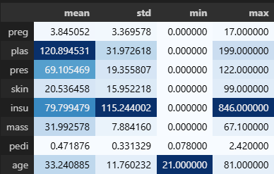
Preprocessing
Data Preprocessing Steps
Identified zeros as missing values in: glucose, blood pressure, skin thickness, insulin, BMI
Replaced with NaN, then imputed using median
Standardized scaling for LogReg & MLP (gradient-based models)
Stratified 80/20 train-test split (preserve class balance)
Fig: Summary Statistics
Caption: Zero values in clinical variables (plas, pres, skin, insu, mass) treated as missing.

Slide 11
Models

Slide 12
Choice of Models
Content
Logistic Regression (LogReg) – Widely used in medical research due to simplicity and interpretability – Coefficients directly map to odds ratios, familiar to clinicians – Baseline for transparent decision-making
Gradient Boosting (GBM) – Ensemble of decision trees, strong performance on structured/tabular data – Known for state-of-the-art accuracy in many healthcare ML tasks – Handles nonlinearities and interactions without manual feature engineering
Neural Network (MLP) – Captures complex nonlinear patterns – Provides contrast to tree-based models – Demonstrates challenges of explaining deep black-box models

Slide 13
Pipelines
Model Pipelines
Logistic Regression pipeline – Impute missing values (median) – Scale features (StandardScaler) – Logistic Regression classifier
GBM pipeline – Impute missing values (median) – Gradient Boosting classifier (n_estimators=200, learning_rate=0.05, max_depth=3)
MLP pipeline – Impute missing values (median) – Scale features – MLP classifier (hidden layers (64,32), max_iter=1000, ReLU activation)

Slide 14
Evaluation

Slide 15
Performance Metrics
Evaluation Metrics
Metrics used: – Accuracy → overall correctness – Precision → reliability of positive predictions – Recall (Sensitivity) → ability to detect true positives – F1-score → balance of precision & recall – AUC (Area Under ROC Curve) → discrimination ability
Provides a balanced view of classification quality beyond accuracy

Slide 16
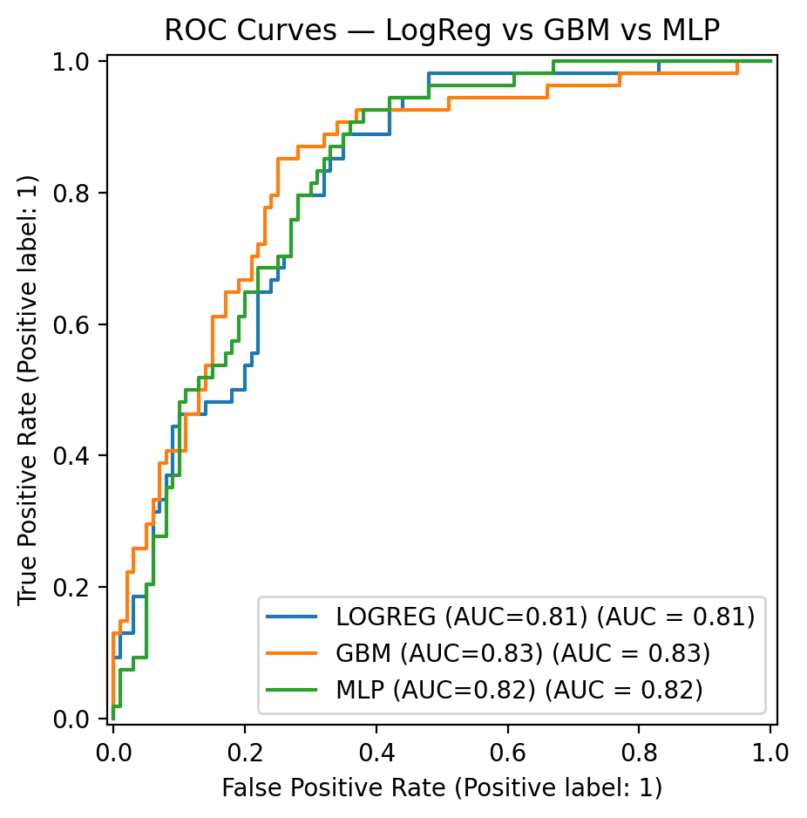
ROC Curves
Visualize trade-off between True Positive Rate and False Positive Rate
Compare all three models: – Logistic Regression (AUC ≈ 0.81) – Gradient Boosting (AUC ≈ 0.83) – MLP (AUC ≈ 0.82)
Observation: Black-box models slightly outperform LogReg, but all models perform comparably

Slide 17
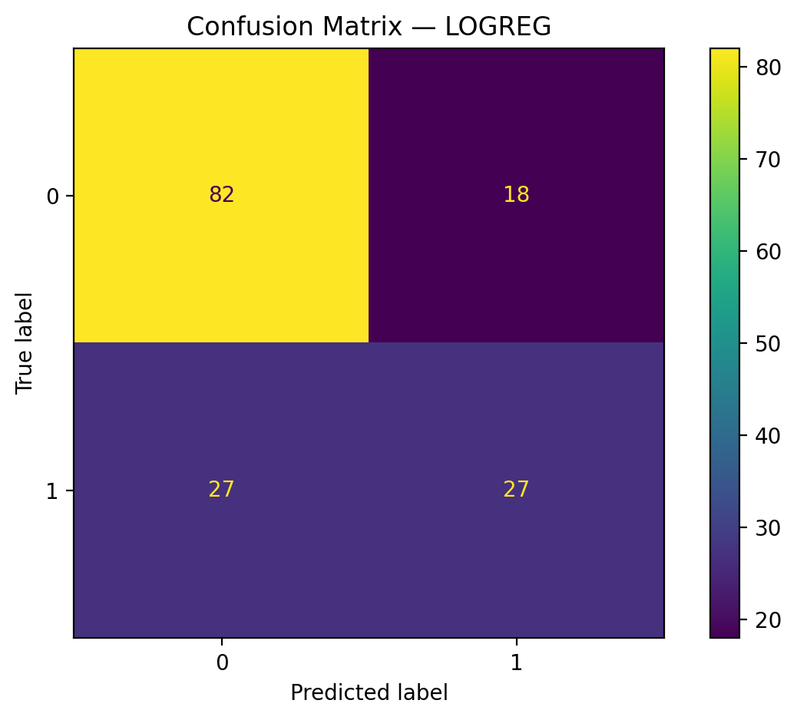
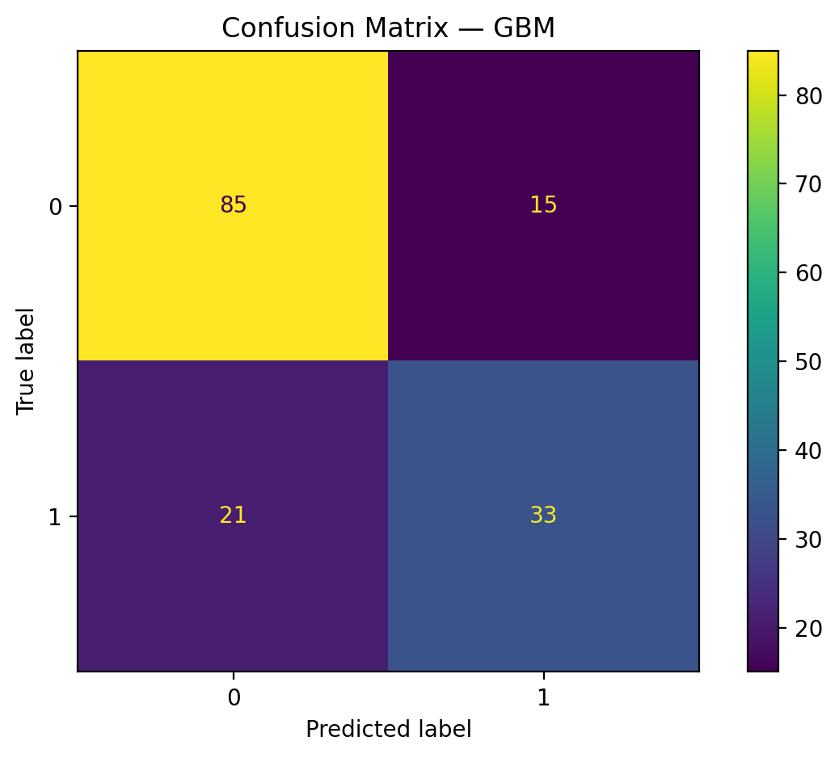
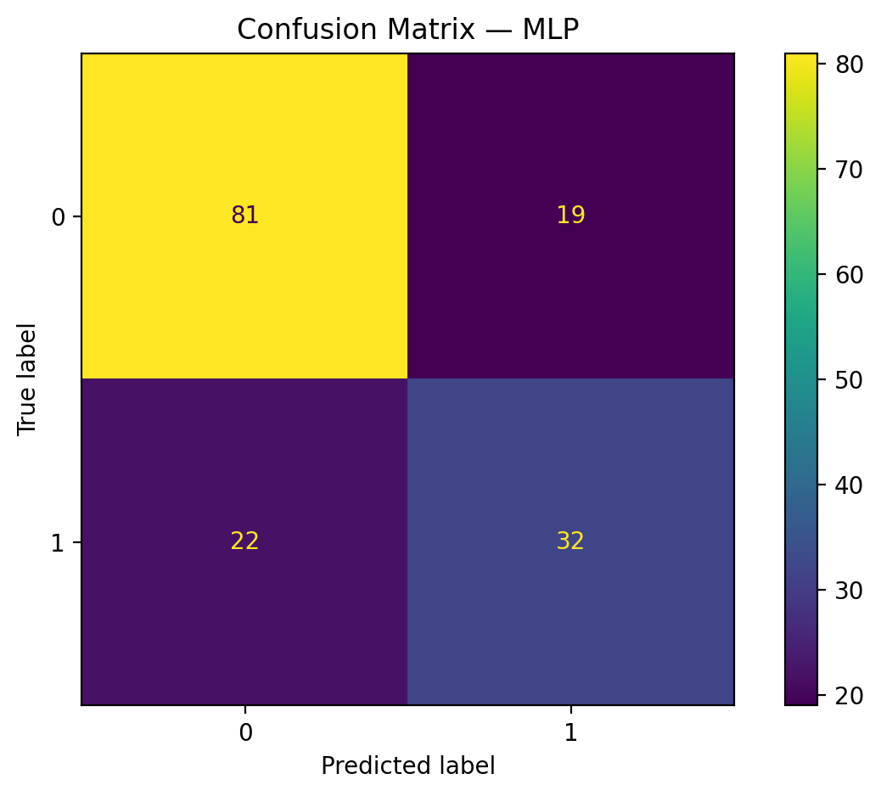
Confusion Matrices
Show model prediction breakdown (True Positives, False Positives, etc.)
Helps interpret errors in clinical context – False negatives (missed diabetes cases) are most critical – Trade-off: avoiding missed diagnoses vs false alarms
Example results: – LogReg: Accuracy ~71% – GBM: Accuracy ~77% – MLP: Accuracy ~75%

Slide 18
Interpretability

Slide 19
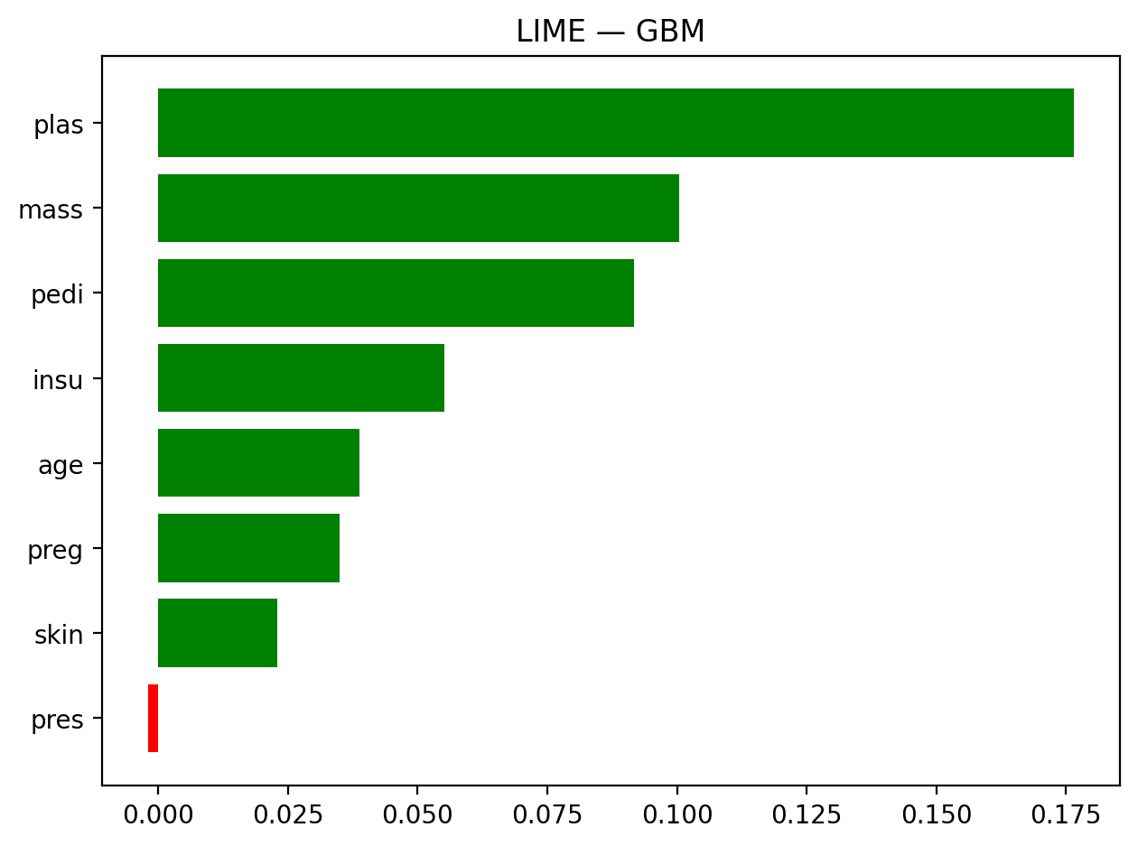
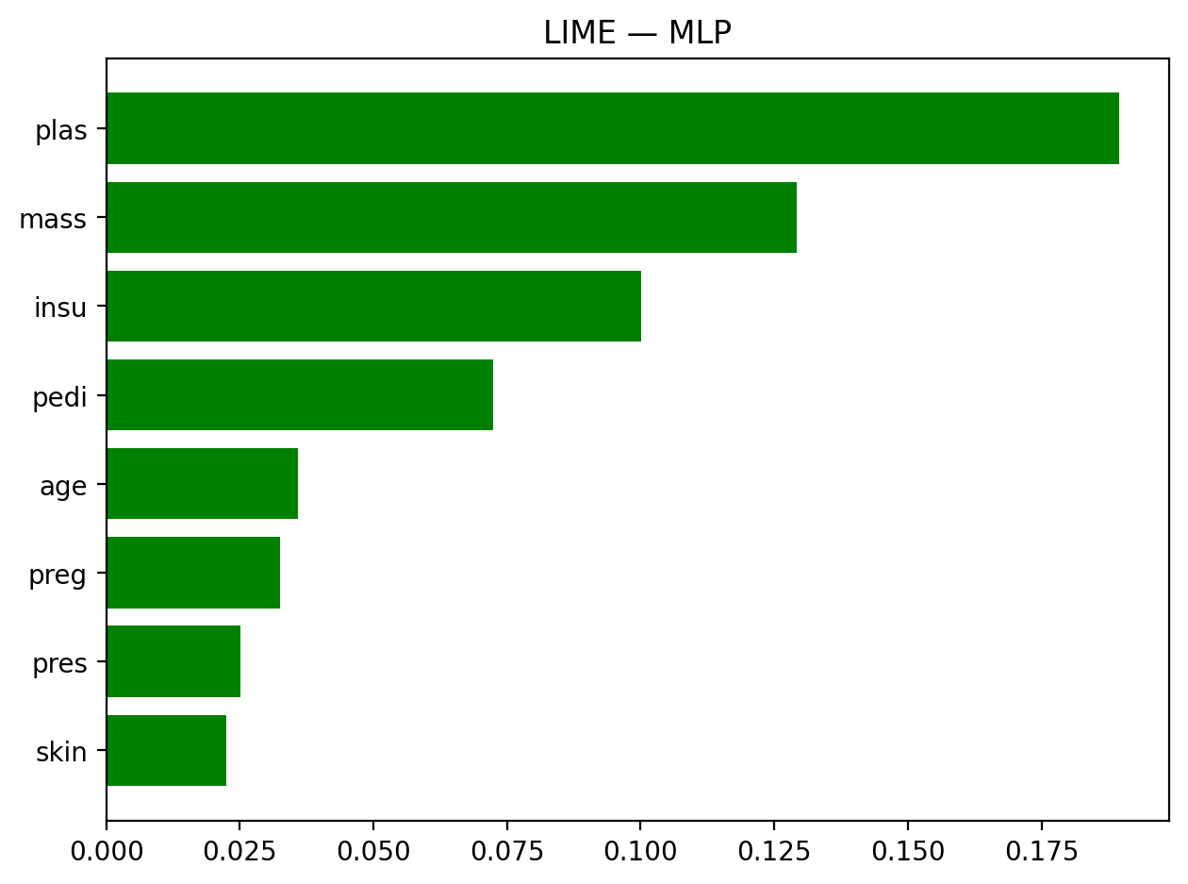
Local Interpretability — LIME
LIME (Local Interpretable Model-agnostic Explanations)
Explains individual patient predictions by fitting a simple surrogate model.
Applied to:
– GBM (tree ensemble)
– MLP (neural network)
Both models highlight Glucose (plas) and BMI (mass) as dominant features.
Consistency across models → increases trust.

Slide 20
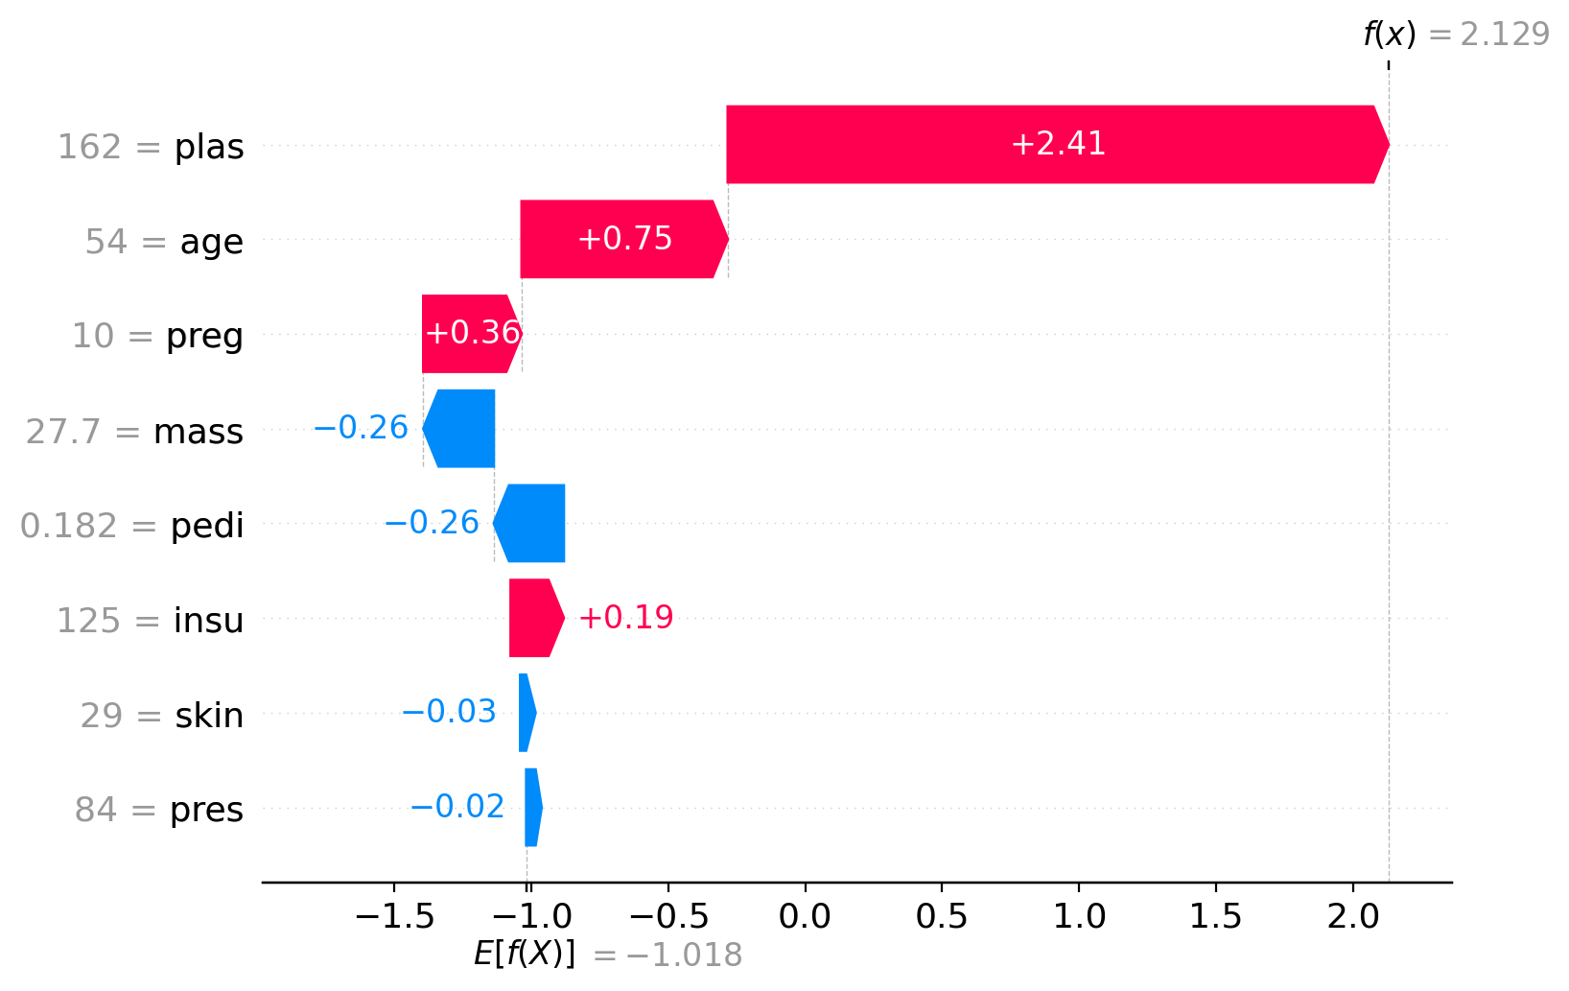
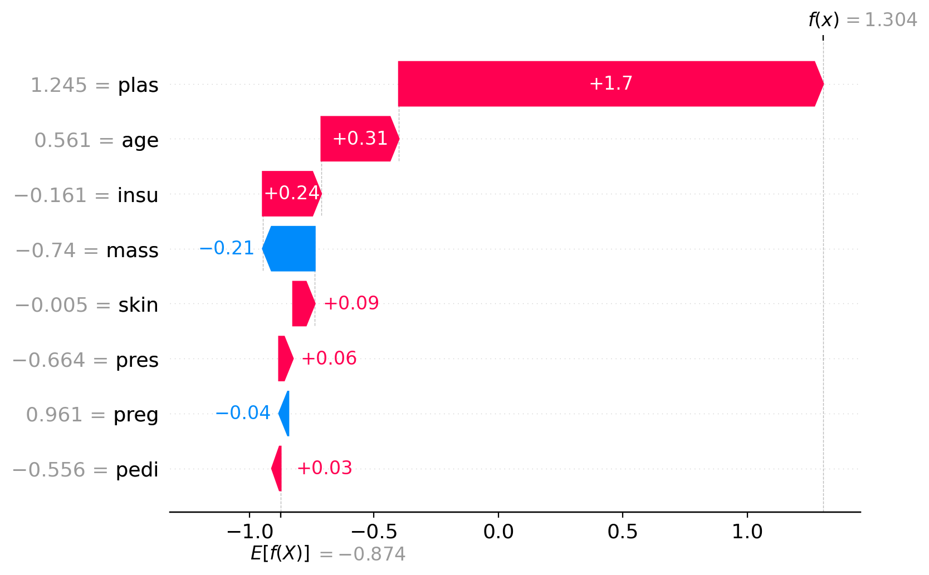
Local Interpretability — SHAP Waterfall
SHAP Waterfall → assigns additive feature contributions for a single patient.
Applied to:
– GBM (TreeExplainer)
– MLP (KernelExplainer)
Shows direction of influence:
Positive (red) → pushes towards diabetes
Negative (blue) → pushes towards no diabetes
Example: High glucose strongly increases prediction probability.
Fig: Gradient Boosting
Fig: Multi-Layer Perceptron

Slide 21
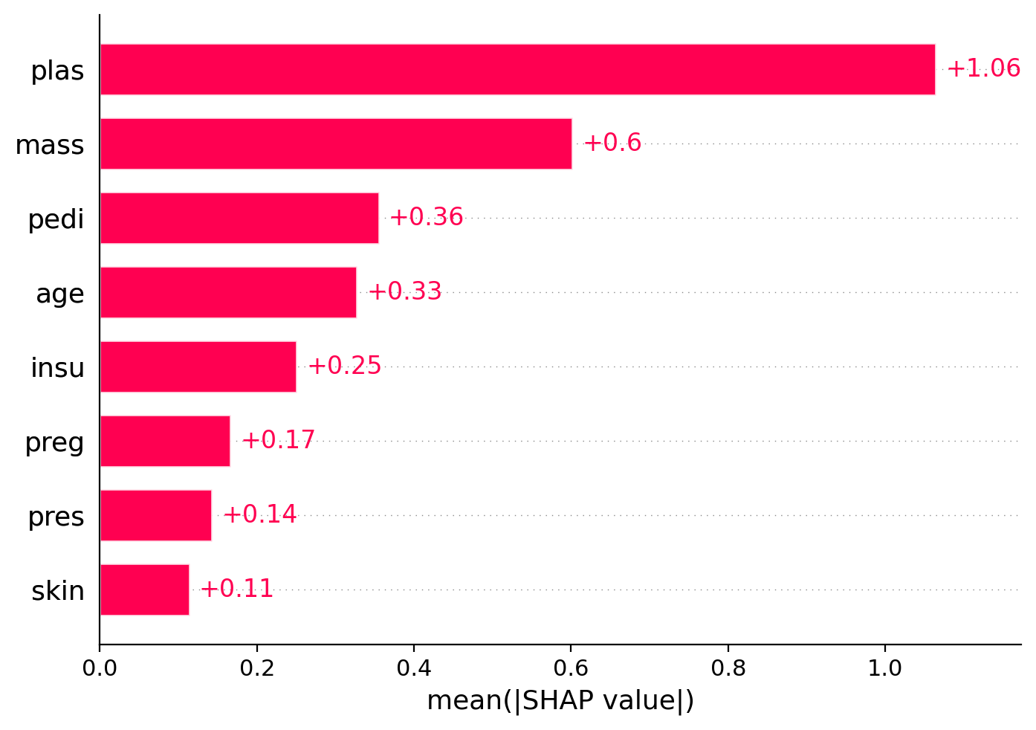
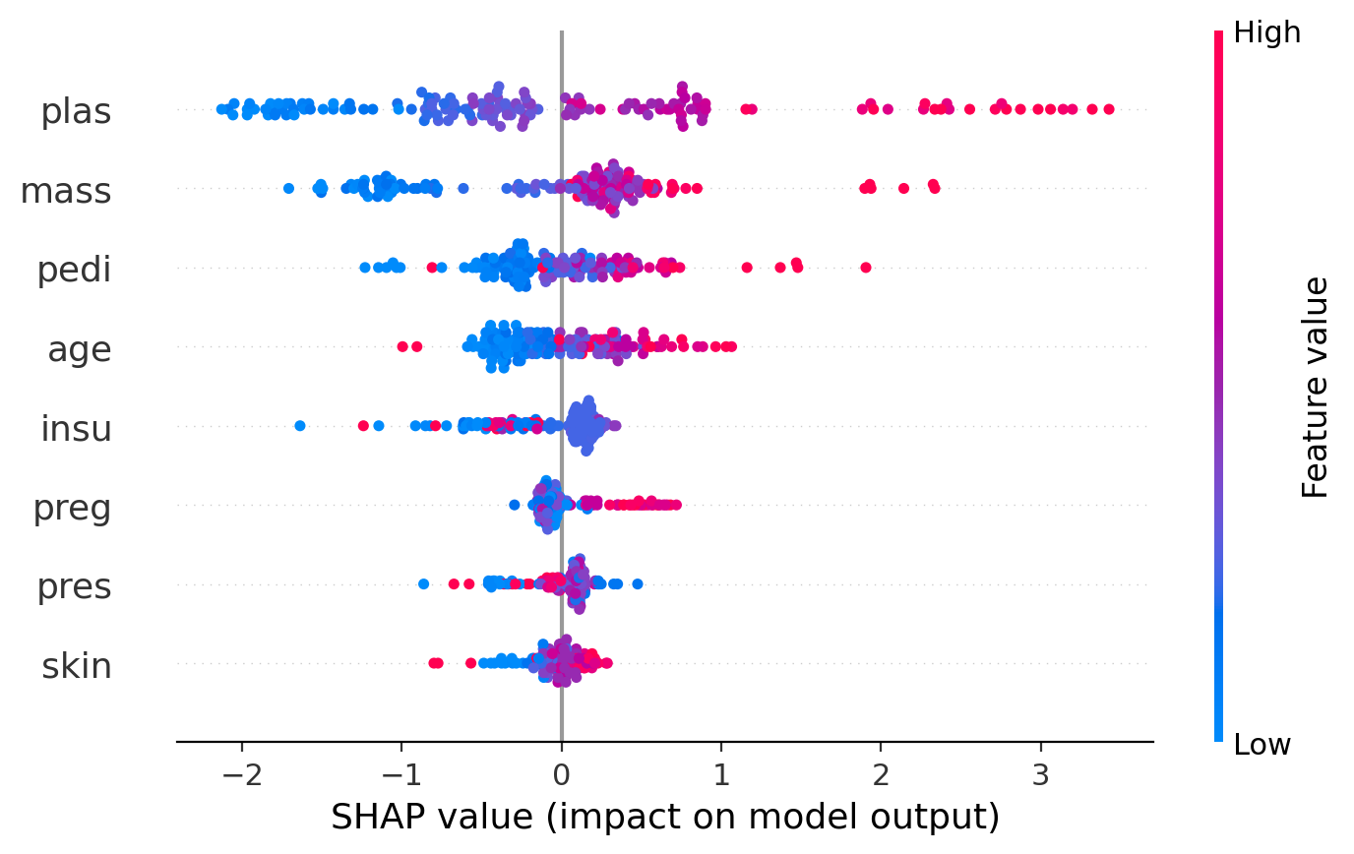
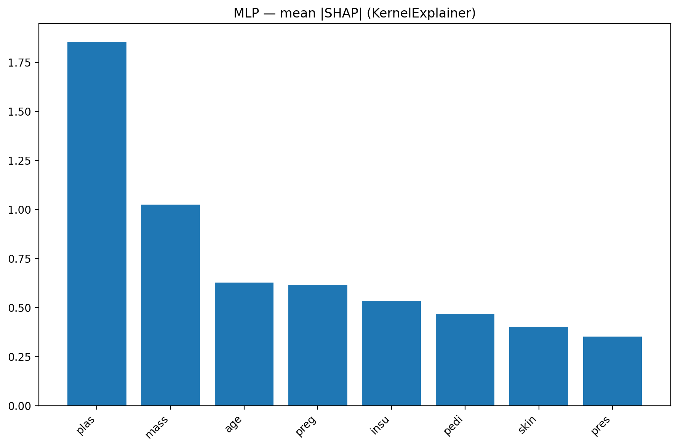
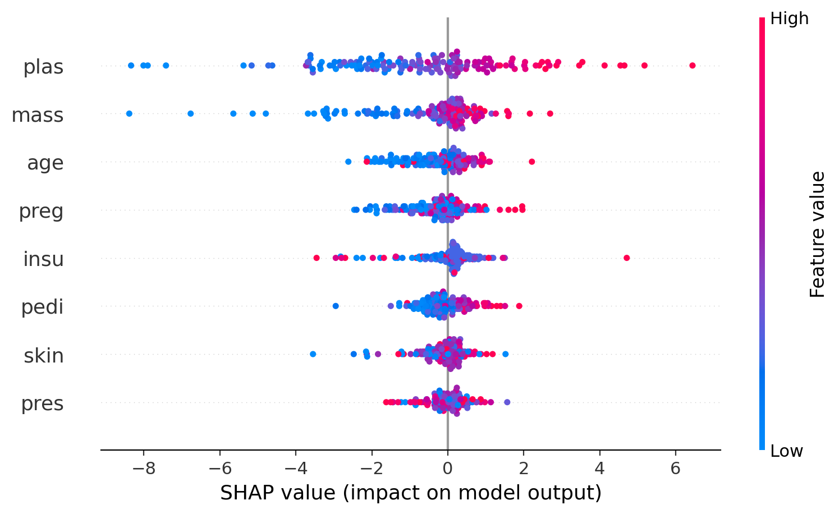
Global Interpretability — SHAP (GBM & MLP)
SHAP Bar Plot → mean absolute SHAP values, feature importance ranking.
SHAP Beeswarm → distribution of SHAP values across patients.
Findings:
– Glucose (plas) is consistently the most important predictor.
– BMI, Pedigree, Age follow closely.
Both GBM & MLP highlight same top features → clinically meaningful.

Slide 22
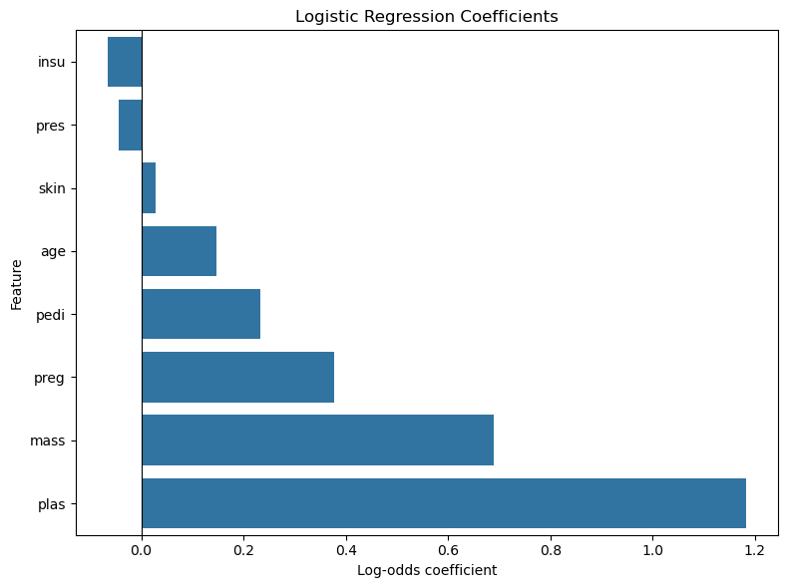
Global Interpretability — SHAP (GBM & MLP)
Logistic Regression is interpretable by design.
Coefficients can be converted to odds ratios (OR):
– Glucose OR ≈ 3.2 → each unit increase triples diabetes risk.
– BMI OR ≈ 2.0 → higher BMI doubles risk.
Interpretation is straightforward and aligns with medical knowledge.

Slide 23
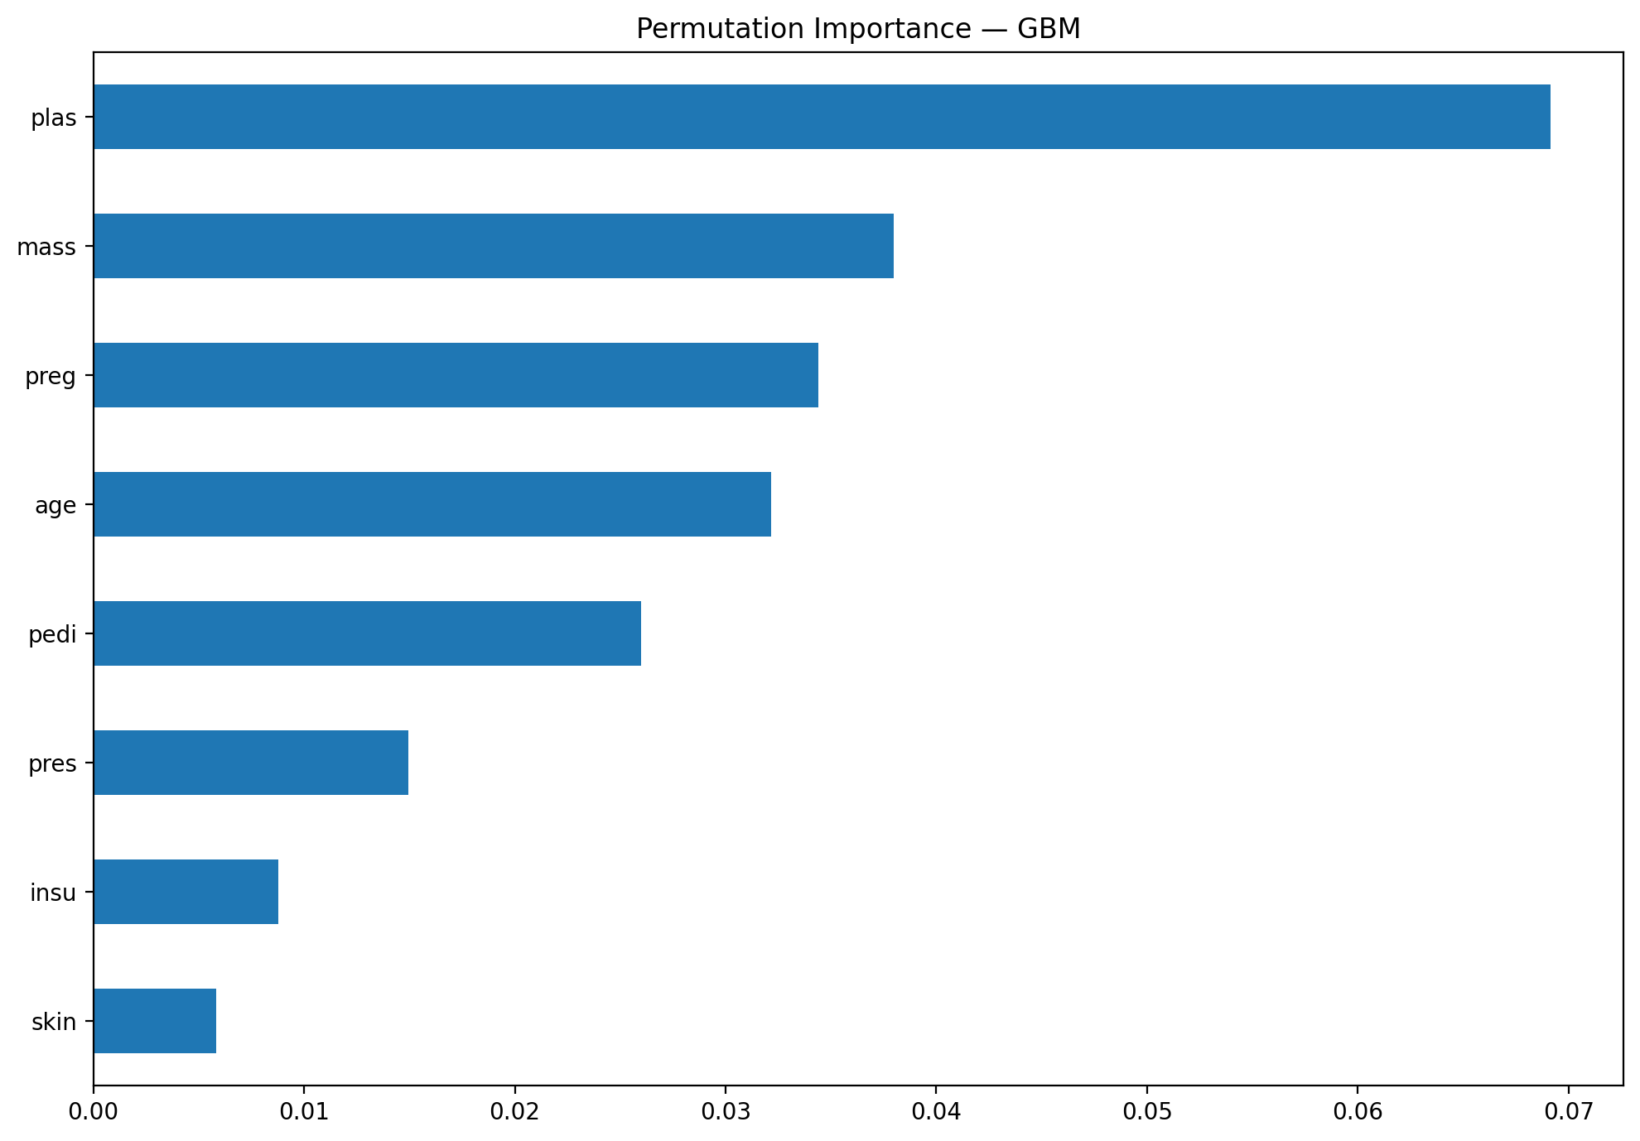
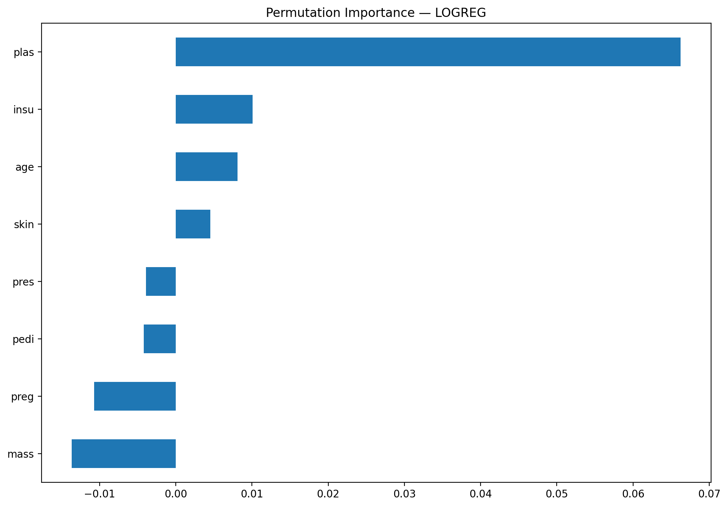
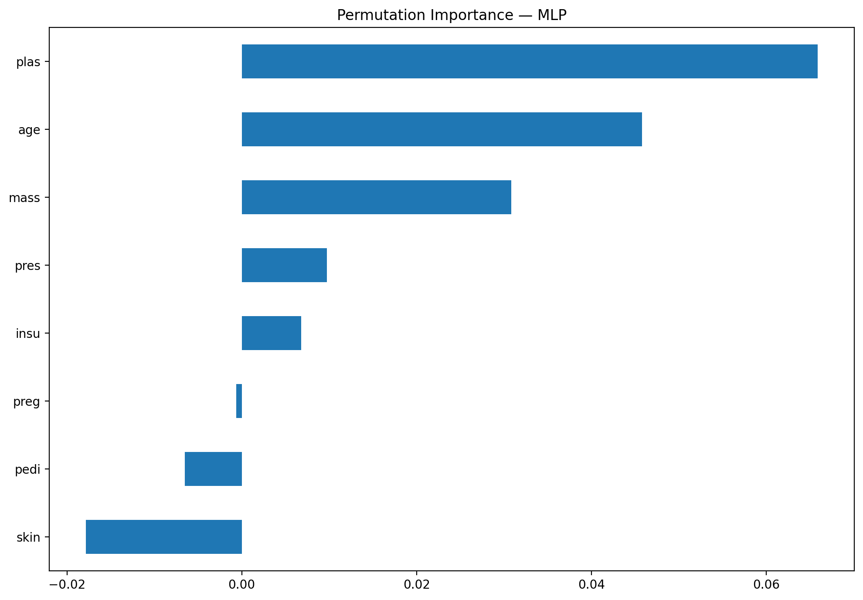
Model-Agnostic Interpretability — Permutation Importance
Permutation Importance: measures drop in accuracy when features are shuffled.
Applied to all models (LogReg, GBM, MLP).
Findings:
– Top features overlap strongly with SHAP results (Glucose, BMI, Pedigree).
– Provides a common baseline across models.

Slide 24
Comparison & Discussion

Slide 25
Performance vs Interpretability
Logistic Regression (LogReg)
Lower predictive performance (AUC ≈ 0.81).
High interpretability: coefficients → odds ratios, easy to explain.
Gradient Boosting (GBM)
Best performance (AUC ≈ 0.83).
Needs post-hoc methods (LIME, SHAP) for interpretability.
Neural Network (MLP)
Similar performance to GBM (AUC ≈ 0.82).
Interpretability more complex (KernelExplainer slower, less precise).

Slide 26
Local Explanations — LIME vs SHAP
LIME
Simple, intuitive explanations.
Sensitive to random sampling → explanations can vary.
SHAP Waterfall
More robust and consistent.
Shows direction (positive/negative contribution).
Finding:
Both methods highlight glucose & BMI as key drivers.
SHAP is more reliable, but LIME is easier to communicate.

Slide 27
Global Explanations — SHAP vs Permutation
SHAP (bar + beeswarm):
Captures both average importance & variation across patients.
Clinically consistent ranking: Glucose > BMI > Pedigree > Age.
Permutation Importance:
Model-agnostic baseline, easy to compare across LogReg, GBM, MLP.
Agrees with SHAP rankings → increases confidence.
Finding:
Agreement across methods + alignment with medical knowledge = trustworthy explanations.

Slide 28
Discussion — Trade-offs
Performance vs Transparency
Black-box models (GBM, MLP) slightly outperform interpretable models.
But post-hoc explanations are required to justify predictions.
Consistency with Medical Knowledge
Key features (Glucose, BMI, Age, Pedigree) match known diabetes risk factors.
Methodological Reflections
LIME: fast but unstable.
SHAP: consistent but computationally heavier (esp. for MLP).
Permutation: simple but ignores feature correlations.

Slide 29
Conclusion & Outlook

Slide 30
Conclusion
Main Findings
Black-box models (GBM, MLP) slightly outperformed Logistic Regression in AUC (~0.83 vs 0.81).
Logistic Regression remains clinically viable due to transparency.
Local (LIME, SHAP) and global (SHAP, Permutation, coefficients) explanations all confirmed: – Glucose and BMI are the strongest predictors. – Age and Pedigree provide moderate contributions.
Takeaway:
Interpretability methods recovered insights consistent with medical knowledge → increases trust in ML models for healthcare.

Slide 31
Future Work
Calibration of predictions
Improve probability estimates for clinical decision-making.
Class imbalance handling
Apply resampling or cost-sensitive learning.
Fairness and bias analysis
Investigate subgroup performance (e.g., gender, age groups).
Scalability
Apply interpretability methods on larger, more diverse datasets.
Advanced explainability
Explore Deep SHAP, Integrated Gradients for neural networks.

Slide 32
References
Dataset
Pima Indians Diabetes Dataset — UCI / OpenML #37 🔗 https://www.openml.org/d/37
Interpretability Methods
Ribeiro, M. T., Singh, S., & Guestrin, C. (2016). “Why Should I Trust You?”: Explaining the Predictions of Any Classifier. KDD ’16. 🔗 https://arxiv.org/abs/1602.04938
Lundberg, S. M., & Lee, S.-I. (2017). A Unified Approach to Interpreting Model Predictions. NeurIPS ’17. 🔗 https://arxiv.org/abs/1705.07874
Model Justifications
Hosmer, D. W., Lemeshow, S., & Sturdivant, R. X. (2013). Applied Logistic Regression (3rd ed.). Wiley. 🔗 https://onlinelibrary.wiley.com/doi/book/10.1002/9781118548387
Chen, T., & Guestrin, C. (2016). XGBoost: A Scalable Tree Boosting System. KDD ’16. 🔗 https://dl.acm.org/doi/10.1145/2939672.2939785
Miotto, R., Wang, F., Wang, S., Jiang, X., & Dudley, J. T. (2018). Deep learning for healthcare: review, opportunities and challenges. Briefings in Bioinformatics, 19(6). 🔗 https://doi.org/10.1093/bib/bbx044
Libraries / Tools
Pedregosa, F. et al. (2011). Scikit-learn: Machine Learning in Python. JMLR, 12, 2825–2830. 🔗 https://jmlr.csail.mit.edu/papers/v12/pedregosa11a.html
SHAP Documentation 🔗 https://shap.readthedocs.io
LIME Documentation 🔗 https://github.com/marcotcr/lime

Slide 33
Vielen Dank
für Ihre Aufmerksamkeit!

